Slide 1
CSE 215: Algorithms
Graph Algorithms

Slide 2
Review: Graphs
A graph G = (V, E)
  V = set of vertices, E = set of edges
  Dense graph: |E| ≈ |V|²; Sparse graph: |E| ≈ |V|
  Undirected graph:
    Edge (u,v) = edge (v,u)
    No self-loops
  Directed graph:
    Edge (u,v) goes from vertex u to vertex v, notated u→v
  A weighted graph associates weights with either the edges or the vertices

Slide 3
Review: Representing Graphs
Assume V = {1, 2, …, n}
An adjacency matrix represents the graph as a n x n matrix A:
  A[i, j] = 1 if edge (i, j) ∈ E (or weight of edge)
  = 0 if edge (i, j) ∉ E
  Storage requirements: O(V²)
    A dense representation
  But, can be very efficient for small graphs
    Especially if store just one bit/edge
    Undirected graph: only need one diagonal of matrix

Slide 4
Review: Graph Searching
Given: a graph G = (V, E), directed or undirected
Goal: methodically explore every vertex and every edge
Ultimately: build a tree on the graph
  Pick a vertex as the root
  Choose certain edges to produce a tree
  Note: might also build a forest if graph is not connected

Slide 5
Review: Breadth-First Search
“Explore” a graph, turning it into a tree
  One vertex at a time
  Expand frontier of explored vertices across the breadth of the frontier
Builds a tree over the graph
  Pick a source vertex to be the root
  Find (“discover”) its children, then their children, etc.

Slide 6
Review: Breadth-First Search
Again will associate vertex “colors” to guide the algorithm
  White vertices have not been discovered
    All vertices start out white
  Grey vertices are discovered but not fully explored
    They may be adjacent to white vertices
  Black vertices are discovered and fully explored
    They are adjacent only to black and gray vertices
Explore vertices by scanning adjacency list of grey vertices

Slide 7
Breadth-first search
Breadth-first search is one of the simplest algorithms for searching a graph and
the archetype for many important graph algorithms. Prim’s minimum-spanningtree
algorithm (Section 23.2) and Dijkstra’s single-source shortest-paths algorithm
(Section 24.3) use ideas similar to those in breadth-first search.
Given a graph G D .V;E/ and a distinguished source vertex s, breadth-first
search systematically explores the edges of G to “discover” every vertex that is
reachable from s. It computes the distance (smallest number of edges) from s
to each reachable vertex. It also produces a “breadth-first tree” with root s that
contains all reachable vertices. For any vertex reachable from s, the simple path
in the breadth-first tree from s to corresponds to a “shortest path” from s to
in G, that is, a path containing the smallest number of edges. The algorithm works
on both directed and undirected graphs.

Slide 8
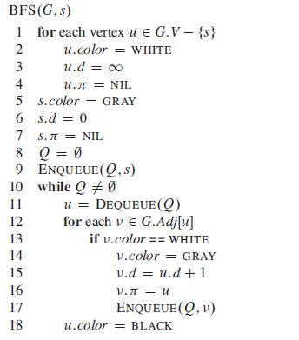


Slide 9
Review: Breadth-First Search
BFS(G, s) {
initialize vertices;
Q = {s}; // Q is a queue (duh); initialize to s
while (Q not empty) {
u = RemoveTop(Q);
for each v ∈ u->adj {
if (v->color == WHITE)
v->color = GREY;
v->d = u->d + 1;
v->p = u;
Enqueue(Q, v);
}
u->color = BLACK;
}
}
What does v->d represent?
What does v->p represent?

Slide 10
Breadth-First Search: Example
r
s
t
u
∞
∞
∞
∞
∞
∞
∞
∞
v
w
x
y

Slide 11
Breadth-First Search: Example
r
s
t
u
∞
0
∞
∞
∞
∞
∞
∞
v
w
x
y
Q:
s

Slide 12
Breadth-First Search: Example
r
s
t
u
1
0
∞
∞
∞
1
∞
∞
v
w
x
y
Q:
w
r

Slide 13
Breadth-First Search: Example
r
s
t
u
1
0
2
∞
∞
1
2
∞
v
w
x
y
Q:
r
t
x

Slide 14
Breadth-First Search: Example
r
s
t
u
1
0
2
∞
2
1
2
∞
v
w
x
y
Q:
t
x
v

Slide 15
Breadth-First Search: Example
r
s
t
u
1
0
2
3
2
1
2
∞
v
w
x
y
Q:
x
v
u

Slide 16
Breadth-First Search: Example
r
s
t
u
1
0
2
3
2
1
2
3
v
w
x
y
Q:
v
u
y

Slide 17
Breadth-First Search: Example
r
s
t
u
1
0
2
3
2
1
2
3
v
w
x
y
Q:
u
y

Slide 18
Breadth-First Search: Example
r
s
t
u
1
0
2
3
2
1
2
3
v
w
x
y
Q:
y

Slide 19
Breadth-First Search: Example
r
s
t
u
1
0
2
3
2
1
2
3
v
w
x
y
Q:
Ø

Slide 20
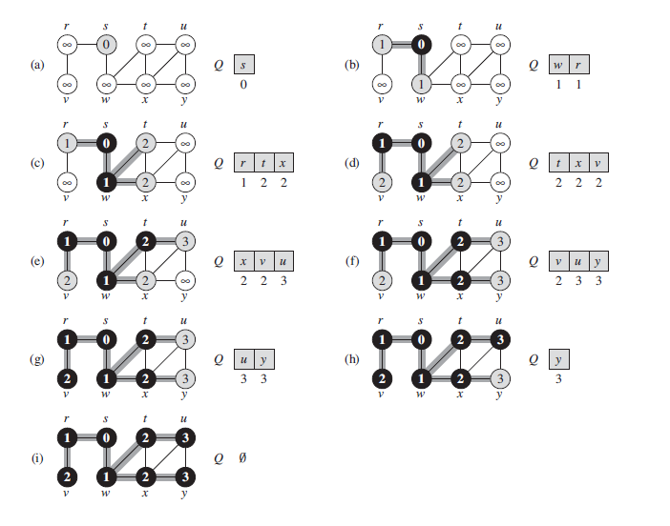

Slide 21
BFS: The Code Again
BFS(G, s) {
initialize vertices;
Q = {s};
while (Q not empty) {
u = RemoveTop(Q);
for each v ∈ u->adj {
if (v->color == WHITE)
v->color = GREY;
v->d = u->d + 1;
v->p = u;
Enqueue(Q, v);
}
u->color = BLACK;
}
}
Touch every vertex: O(V)
u = every vertex, but only once
(Why?)
So v = every vertex that appears in some other vert’s adjacency list
What will be the running time?
Total running time: O(V+E)

Slide 22
BFS: The Code Again
BFS(G, s) {
initialize vertices;
Q = {s};
while (Q not empty) {
u = RemoveTop(Q);
for each v ∈ u->adj {
if (v->color == WHITE)
v->color = GREY;
v->d = u->d + 1;
v->p = u;
Enqueue(Q, v);
}
u->color = BLACK;
}
}
What will be the storage cost
in addition to storing the graph?
Total space used:
O(max(degree(v))) = O(E)

Slide 23
Breadth-First Search: Properties
BFS calculates the shortest-path distance to the source node
  Shortest-path distance δ(s,v) = minimum number of edges from s to v, or ∞ if v not reachable from s
  Proof given in the book (p. 472-5)
BFS builds breadth-first tree, in which paths to root represent shortest paths in G
  Thus can use BFS to calculate shortest path from one vertex to another in O(V+E) time

Slide 24
Depth-First Search
Depth-first search is another strategy for exploring a graph
  Explore “deeper” in the graph whenever possible
  Edges are explored out of the most recently discovered vertex v that still has unexplored edges
  When all of v’s edges have been explored, backtrack to the vertex from which v was discovered

Slide 25
Depth-First Search
Vertices initially colored white
Then colored gray when discovered
Then black when finished

Slide 26
Depth-First Search: The Code
DFS(G)
{
for each vertex u ∈ G->V
{
u->color = WHITE;
}
time = 0;
for each vertex u ∈ G->V
{
if (u->color == WHITE)
DFS_Visit(u);
}
}
DFS_Visit(u)
{
u->color = GREY;
time = time+1;
u->d = time;
for each v ∈ u->Adj[]
{
if (v->color == WHITE)
DFS_Visit(v);
}
u->color = BLACK;
time = time+1;
u->f = time;
}

Slide 27
Depth-First Search: The Code
DFS(G)
{
for each vertex u ∈ G->V
{
u->color = WHITE;
}
time = 0;
for each vertex u ∈ G->V
{
if (u->color == WHITE)
DFS_Visit(u);
}
}
DFS_Visit(u)
{
u->color = GREY;
time = time+1;
u->d = time;
for each v ∈ u->Adj[]
{
if (v->color == WHITE)
DFS_Visit(v);
}
u->color = BLACK;
time = time+1;
u->f = time;
}
What does u->d represent?

Slide 28
Depth-First Search: The Code
DFS(G)
{
for each vertex u ∈ G->V
{
u->color = WHITE;
}
time = 0;
for each vertex u ∈ G->V
{
if (u->color == WHITE)
DFS_Visit(u);
}
}
DFS_Visit(u)
{
u->color = GREY;
time = time+1;
u->d = time;
for each v ∈ u->Adj[]
{
if (v->color == WHITE)
DFS_Visit(v);
}
u->color = BLACK;
time = time+1;
u->f = time;
}
What does u->f represent?

Slide 29
Depth-First Search: The Code
DFS(G)
{
for each vertex u ∈ G->V
{
u->color = WHITE;
}
time = 0;
for each vertex u ∈ G->V
{
if (u->color == WHITE)
DFS_Visit(u);
}
}
DFS_Visit(u)
{
u->color = GREY;
time = time+1;
u->d = time;
for each v ∈ u->Adj[]
{
if (v->color == WHITE)
DFS_Visit(v);
}
u->color = BLACK;
time = time+1;
u->f = time;
}
Will all vertices eventually be colored black?

Slide 30
Depth-First Search: The Code
DFS(G)
{
for each vertex u ∈ G->V
{
u->color = WHITE;
}
time = 0;
for each vertex u ∈ G->V
{
if (u->color == WHITE)
DFS_Visit(u);
}
}
DFS_Visit(u)
{
u->color = GREY;
time = time+1;
u->d = time;
for each v ∈ u->Adj[]
{
if (v->color == WHITE)
DFS_Visit(v);
}
u->color = BLACK;
time = time+1;
u->f = time;
}
What will be the running time?

Slide 31
Depth-First Search: The Code
DFS(G)
{
for each vertex u ∈ G->V
{
u->color = WHITE;
}
time = 0;
for each vertex u ∈ G->V
{
if (u->color == WHITE)
DFS_Visit(u);
}
}
DFS_Visit(u)
{
u->color = GREY;
time = time+1;
u->d = time;
for each v ∈ u->Adj[]
{
if (v->color == WHITE)
DFS_Visit(v);
}
u->color = BLACK;
time = time+1;
u->f = time;
}
Running time: O(n²) because call DFS_Visit on each vertex,
and the loop over Adj[] can run as many as |V| times

Slide 32
Depth-First Search: The Code
DFS(G)
{
for each vertex u ∈ G->V
{
u->color = WHITE;
}
time = 0;
for each vertex u ∈ G->V
{
if (u->color == WHITE)
DFS_Visit(u);
}
}
DFS_Visit(u)
{
u->color = GREY;
time = time+1;
u->d = time;
for each v ∈ u->Adj[]
{
if (v->color == WHITE)
DFS_Visit(v);
}
u->color = BLACK;
time = time+1;
u->f = time;
}
BUT, there is actually a tighter bound.
How many times will DFS_Visit() actually be called?

Slide 33
Depth-First Search: The Code
DFS(G)
{
for each vertex u ∈ G->V
{
u->color = WHITE;
}
time = 0;
for each vertex u ∈ G->V
{
if (u->color == WHITE)
DFS_Visit(u);
}
}
DFS_Visit(u)
{
u->color = GREY;
time = time+1;
u->d = time;
for each v ∈ u->Adj[]
{
if (v->color == WHITE)
DFS_Visit(v);
}
u->color = BLACK;
time = time+1;
u->f = time;
}
So, running time of DFS = O(V+E)

Slide 34
Depth-First Sort Analysis
This running time argument is an informal example of amortized analysis
  “Charge” the exploration of edge to the edge:
    Each loop in DFS_Visit can be attributed to an edge in the graph
    Runs once/edge if directed graph, twice if undirected
    Thus loop will run in O(E) time, algorithm O(V+E)
      Considered linear for graph, b/c adj list requires O(V+E) storage
  Important to be comfortable with this kind of reasoning and analysis

Slide 35
22.3 Depth-first search
The strategy followed by depth-first search is, as its name implies, to search
“deeper” in the graph whenever possible. Depth-first search explores edges out
of the most recently discovered vertex that still has unexplored edges leaving it.
Once all of ’s edges have been explored, the search “backtracks” to explore edges
leaving the vertex from which was discovered. This process continues until we
have discovered all the vertices that are reachable from the original source vertex.
If any undiscovered vertices remain, then depth-first search selects one of them as
a new source, and it repeats the search from that source. The algorithm repeats this
entire process until it has discovered every vertex.3

Slide 36
As in breadth-first search, whenever depth-first search discovers a vertex during
a scan of the adjacency list of an already discovered vertex u, it records this
event by setting ’s predecessor attribute : to u. Unlike breadth-first search,
whose predecessor subgraph forms a tree, the predecessor subgraph produced by
a depth-first search may be composed of several trees, because the search may
repeat from multiple sources. Therefore, we define the predecessor subgraph of
a depth-first search slightly differently from that of a breadth-first search: we let
G D .V;E/, where
E D f.:; / W 2 V and : ¤ NILg :

Slide 37
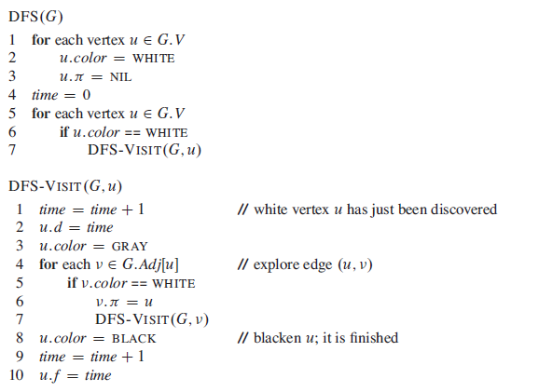

Slide 38
DFS Example
source
vertex

Slide 39
DFS Example
source
vertex
d f
1 |
|
|
|
|
|
|
|

Slide 40
DFS Example
source
vertex
d f
1 |
|
|
2 |
|
|
|
|

Slide 41
DFS Example
source
vertex
d f
1 |
|
|
2 |
|
3 |
|
|

Slide 42
DFS Example
source
vertex
d f
1 |
|
|
2 |
|
3 | 4
|
|

Slide 43
DFS Example
source
vertex
d f
1 |
|
|
2 |
|
3 | 4
5 |
|

Slide 44
DFS Example
source
vertex
d f
1 |
|
|
2 |
|
3 | 4
5 | 6
|

Slide 45
DFS Example
source
vertex
d f
1 |
8 |
|
2 | 7
|
3 | 4
5 | 6
|

Slide 46
DFS Example
source
vertex
d f
1 |
8 |
|
2 | 7
|
3 | 4
5 | 6
|

Slide 47
DFS Example
source
vertex
d f
1 |
8 |
|
2 | 7
9 |
3 | 4
5 | 6
|
What is the structure of the grey vertices?
What do they represent?

Slide 48
DFS Example
source
vertex
d f
1 |
8 |
|
2 | 7
9 |10
3 | 4
5 | 6
|

Slide 49
DFS Example
source
vertex
d f
1 |
8 |11
|
2 | 7
9 |10
3 | 4
5 | 6
|

Slide 50
DFS Example
source
vertex
d f
1 |12
8 |11
|
2 | 7
9 |10
3 | 4
5 | 6
|

Slide 51
DFS Example
source
vertex
d f
1 |12
8 |11
13|
2 | 7
9 |10
3 | 4
5 | 6
|

Slide 52
DFS Example
source
vertex
d f
1 |12
8 |11
13|
2 | 7
9 |10
3 | 4
5 | 6
14|

Slide 53
DFS Example
source
vertex
d f
1 |12
8 |11
13|
2 | 7
9 |10
3 | 4
5 | 6
14|15

Slide 54
DFS Example
source
vertex
d f
1 |12
8 |11
13|16
2 | 7
9 |10
3 | 4
5 | 6
14|15

Slide 55
DFS: Kinds of edges
DFS introduces an important distinction among edges in the original graph:
  Tree edge: encounter new (white) vertex
    The tree edges form a spanning forest
    Can tree edges form cycles? Why or why not?

Slide 56
DFS Example
source
vertex
d f
1 |12
8 |11
13|16
2 | 7
9 |10
3 | 4
5 | 6
14|15
Tree edges

Slide 57
DFS: Kinds of edges
DFS introduces an important distinction among edges in the original graph:
  Tree edge: encounter new (white) vertex
  Back edge: from descendent to ancestor
    Encounter a grey vertex (grey to grey)

Slide 58
DFS Example
source
vertex
d f
1 |12
8 |11
13|16
2 | 7
9 |10
3 | 4
5 | 6
14|15
Tree edges
Back edges

Slide 59
DFS: Kinds of edges
DFS introduces an important distinction among edges in the original graph:
  Tree edge: encounter new (white) vertex
  Back edge: from descendent to ancestor
  Forward edge: from ancestor to descendent
    Not a tree edge, though
    From grey node to black node

Slide 60
DFS Example
source
vertex
d f
1 |12
8 |11
13|16
2 | 7
9 |10
3 | 4
5 | 6
14|15
Tree edges
Back edges
Forward edges

Slide 61
DFS: Kinds of edges
DFS introduces an important distinction among edges in the original graph:
  Tree edge: encounter new (white) vertex
  Back edge: from descendent to ancestor
  Forward edge: from ancestor to descendent
  Cross edge: between a tree or subtrees
    From a grey node to a black node

Slide 62
DFS Example
source
vertex
d f
1 |12
8 |11
13|16
2 | 7
9 |10
3 | 4
5 | 6
14|15
Tree edges
Back edges
Forward edges
Cross edges

Slide 63
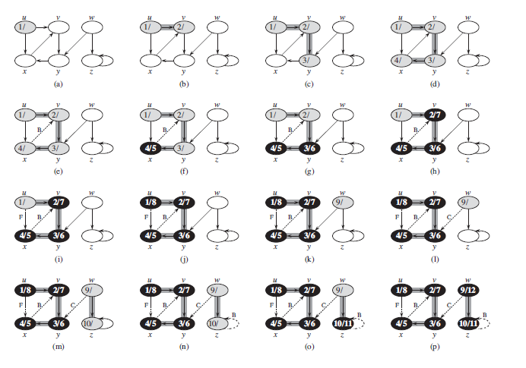

Slide 64
DFS: Kinds of edges
DFS introduces an important distinction among edges in the original graph:
  Tree edge: encounter new (white) vertex
  Back edge: from descendent to ancestor
  Forward edge: from ancestor to descendent
  Cross edge: between a tree or subtrees
Note: tree & back edges are important; most algorithms don’t distinguish forward & cross

Slide 65
DFS: Kinds Of Edges
Thm 23.9: If G is undirected, a DFS produces only tree and back edges
Proof by contradiction:
  Assume there’s a forward edge
    But F? edge must actually be a
    back edge (why?)
source
F?

Slide 66
DFS: Kinds Of Edges
Thm 23.9: If G is undirected, a DFS produces only tree and back edges
Proof by contradiction:
  Assume there’s a cross edge
    But C? edge cannot be cross:
    must be explored from one of the
    vertices it connects, becoming a tree
    vertex, before other vertex is explored
    So in fact the picture is wrong…both
    lower tree edges cannot in fact be
    tree edges
source
C?

Slide 67
DFS And Graph Cycles
Thm: An undirected graph is acyclic iff a DFS yields no back edges
  If acyclic, no back edges (because a back edge implies a cycle
  If no back edges, acyclic
    No back edges implies only tree edges (Why?)
    Only tree edges implies we have a tree or a forest
    Which by definition is acyclic
Thus, can run DFS to find whether a graph has a cycle

Slide 68
DFS And Cycles
How would you modify the code to detect cycles?
DFS(G)
{
for each vertex u ∈ G->V
{
u->color = WHITE;
}
time = 0;
for each vertex u ∈ G->V
{
if (u->color == WHITE)
DFS_Visit(u);
}
}
DFS_Visit(u)
{
u->color = GREY;
time = time+1;
u->d = time;
for each v ∈ u->Adj[]
{
if (v->color == WHITE)
DFS_Visit(v);
}
u->color = BLACK;
time = time+1;
u->f = time;
}

Slide 69
DFS And Cycles
What will be the running time?
DFS(G)
{
for each vertex u ∈ G->V
{
u->color = WHITE;
}
time = 0;
for each vertex u ∈ G->V
{
if (u->color == WHITE)
DFS_Visit(u);
}
}
DFS_Visit(u)
{
u->color = GREY;
time = time+1;
u->d = time;
for each v ∈ u->Adj[]
{
if (v->color == WHITE)
DFS_Visit(v);
}
u->color = BLACK;
time = time+1;
u->f = time;
}

Slide 70
DFS And Cycles
What will be the running time?
A: O(V+E)
We can actually determine if cycles exist in O(V) time:
  In an undirected acyclic forest, |E| ≤ |V| - 1
  So count the edges: if ever see |V| distinct edges, must have seen a back edge along the way

